Slide 1
CS w186 Introduction to Database Systems
Prof. Josh Hug

Slide 2
Essential Queries
Why take this class?
What is this class all about?
Who is running this?
How will this class work?

Slide 3
Who Am I?
6th year faculty at UC Berkeley. Freshly tenured as of July 1st.
My title is “Associate Teaching Professor”. Note the title has the extra word “teaching” in there.
PhD at Berkeley in 2011 modeling signal transduction in bacteria (it was cool).
Moved on to a teaching focused track after grad school because I thought it was more fun.
First job out of grad school was as a lecturer at Princeton from 2011-2014, before coming back to Berkeley.
Came back because UC Berkeley is such a cool place to be. Also the weather and the ocean and the friends.

Slide 4
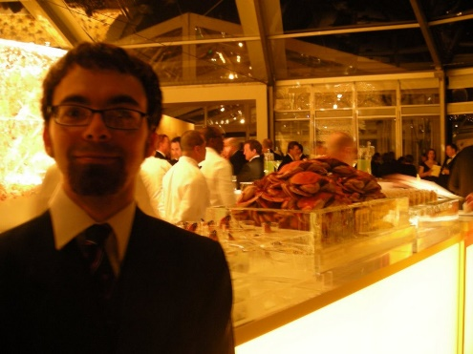

Who Am I? Outside of work
Grew up in Texas. It was fine, but not ideal.
Dad of a cool two year old.
The ocean is my best buddy, and it’s only ~45 minutes away.
When faced with a choice between doing the activity and not doing the activity because I feel a little lazy, I try to always do the activity (and you should, too).
I really like sneaking into places, as well as interesting antics and schemes.

Slide 5
Your Amazing TAs
Angela Xiao
Eric Sheng
Jiayue Li
Jenny Huang
Jenny Wang
David Kim
David Wang
Lakshya Jain (Head TA)
Ethan Shang
Daniel Zhang
Sai Mandava
Jeremy Dong
Charles Lin
Ian Rodney
Jamie Gu
Brian DeLeonardis
John Yang
Jasmine Le

Slide 6
You!
This class is in your hands.
Everything is doable, with steady work.
We will help pace you
Weekly section worksheets, vitamins keep you on schedule
Weekly in-person sections and office hours
But now more than ever, success is in your hands

Slide 7
Essential Queries
Why take this class?
What is this class all about?
Who is running this?
How will this class work?

Slide 8
A Note on CS w186
This course was created by Joe Hellerstein!
His decades of experience with databases are the soul of this course.
By contrast, I (Josh Hug) am basically the equivalent of a machine operator.
No live lectures.
Will not be designing new homeworks or exercises.
My role will be almost entirely behind the scenes - but feel free to come to office hours.

Slide 9
Why w186?
In Fa07/Sp08, EECS taught 22,660 student credit hours worth of courses.
In Fa19/Sp20, we expect to teach 90,000+.
Though teaching load has quadrupled, the faculty has gone from ~90 to ~114.
This semester’s class is an experiment to try to serve the students better by streamlining faculty teaching load. Let us know what you think on surveys.

Slide 10
What is different about CS w186?
Main difference: online lecture content
No in-person lectures
3-5 minute videos on edX
Each followed by an online Quick Check
Reinforce the basics
Otherwise, things are largely standard
In-Person Discussion sections
Worksheet will be online in advance
In-person TA and Prof Office Hours

Slide 11
Main Sources of Information
Piazza discussion forum
This is your most important resource, and you are responsible to read pinned posts!
Course Website: www.cs186berkeley.net
Calendar: sections and OH
Links to resources like course drive, edX
Syllabus
FAQs
Course Content on EdX
Video lectures corresponding to slides
Quick Check exercises to reinforce lecture content
Mandatory weekly Vitamins to assess understanding
All this info linked on website.

Slide 12
Workload
Weekly “lecture” style work
Lecture exercises:
Intermixed with lecture videos
Vitamins: simple weekly online quizzes – 10% of your grade
You can drop 2
Exercises must be completed to submit vitamin.
5 programming homeworks (next slide) – 35% of your grade
2 midterm exams: 30% of your grade
MT1: Friday, Oct. 4, 8-10 PM
MT2: Friday, Nov. 8: 8-10 PM
Worse exam is 12% of your grade, better exam is 18%
1 final exam – 25% of your grade
Wednesday, Dec. 18, 11:30 AM - 2:30 PM
Schedule for homeworks and exams on the website

Slide 13
Homeworks
Real-world focus
SQL querying: basics and algorithmics
Building pieces of a DBMS
B+-tree indexes
Join Algorithms
Dynamic Programming Query Optimizer
Concurrency (2PL) and Recovery (ARIES)
HW0 out now!
HW1 goes out next week!!

Slide 14
Cheating policy
Zero Tolerance. It is uncool. Don’t.
We have the technology to find out.
We know that most cheating happens due to stress
Plan ahead and stay on schedule to minimize stress
You have built-in safety valves
Dropped vitamins
Slip days on homeworks: save for when you need them, don’t micro-optimize!
Midterms weighted to the higher grade
Keep an eye on the course drop date. Don’t take too many courses!
Feeling stressed? Reach out!
Campus resources
Course staff is here for you
Incompletes are appropriate for health issues of any kind
Staff perspective
We want you to learn and to succeed
We want things to be fair, so need to stick to rules

Slide 15
Staying in touch
All class communication via Piazza
https://piazza.com/berkeley/fall2019/csw186
We will go live with answers today
Announcements and discussion
read it regularly
post all questions/comments there
answer each other’s questions!
Direct email to cs186berkeley.issues@gmail.com if you have a logistical or otherwise sensitive question that you’d prefer not to post on piazza.

Slide 16

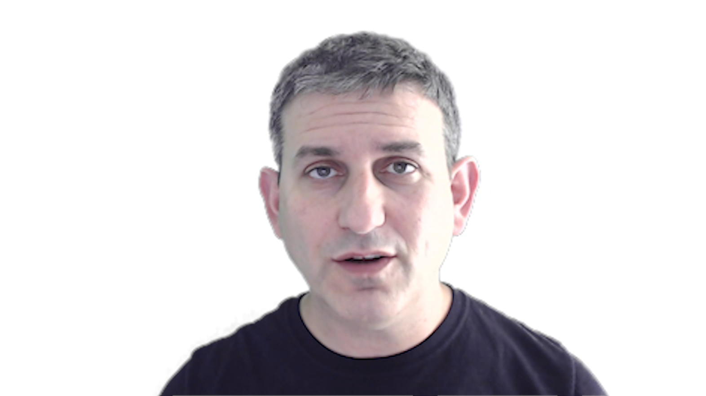
See you online!

